Slide 1



Satellite-based solutions for Train Control Systems
European Parliament, Brussels
Tuesday, 11 February 2014
Francesco Rispoli, Manager Satellite Technology
Ansaldo STS

Slide 2

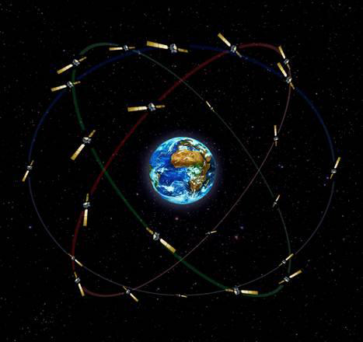
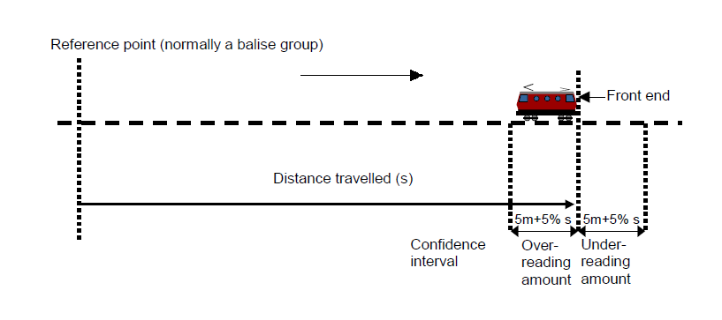
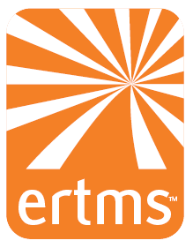
“Satellite navigation is set to revolutionise the rail sector, and ETCS will make it possible to monitor the exact location of each train in real time”
Safe train positioning
ERTMS is a major European industrial project (similar to Galileo for satellite navigation or SESAR in air traffic management) and provides increased export opportunities for the EU.

Slide 3
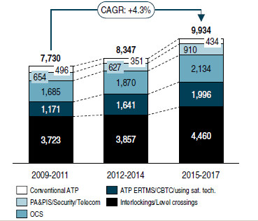
ERTMS: new challenges & opportunities
ERTMS: a de-facto standard in the global signaling market. However:
Market Analyses showed that the system could be even more successful if a number of improvements would be implemented such as Satellite Navigation
New emerging US-led projects are benefitting from satellite technology transfer by the defense industry
UNIFE Worldwide Rail Market Study 2012

Slide 4






The virtuous cycle
Increase
market
Virtual balise
Satellite-based solutions for Train Control Systems
Making investments more
attractive
Space
technology
Rail applications
Ensure
ERTMS
compatibility
Exploit new
technologies
EGNSS
EGNOS operative
GALILEO under development
ERTMS
Lower operational costs
Improve competitivity

Slide 5
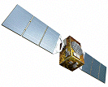
Technology shift
Move the “intelligence” from the track side to the trains
Use GNSS to replace the fixed blocks and reduce trackside equipments
Improve the safety especially on low traffic lines
Increase the frequency of train without investing on the infrastructure
A public EGNOS-GALILEO infrastructure is key to provide positioning function to the ERTMS
EGNSS
(EGNOS, GPS
Galileo)

Slide 6
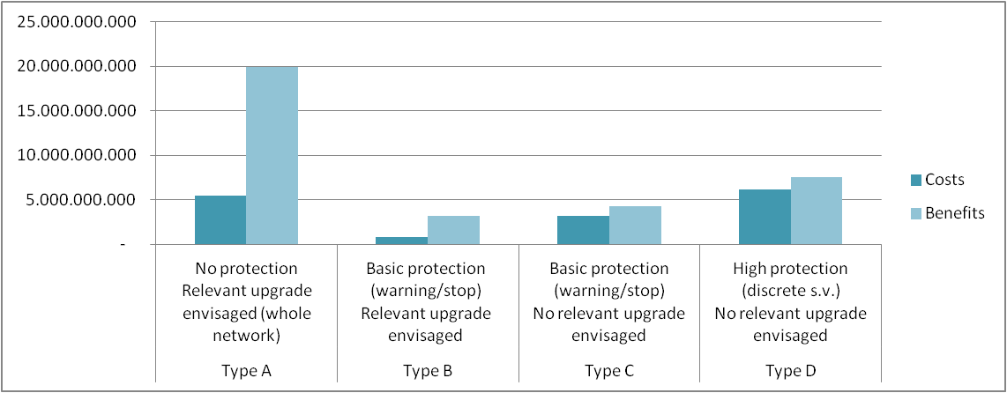
Potential Benefits
Costs and benefits (NPV in 35 years) by type of line (Euro)
RAIL
Bocconi: Economic evaluation of the introduction of GNSS technologies on the Train Control Systems
GNSS
Lower operational costs
Increase safety
Increase of rail track capacity
Lower infrastructure charges
Increase utilisation of EGNOS
Reinforce the EGNOS network
New applications for GALILEO
New industrial returns for space
Incentivate the penetration of ERTMS-ETCS

Slide 7
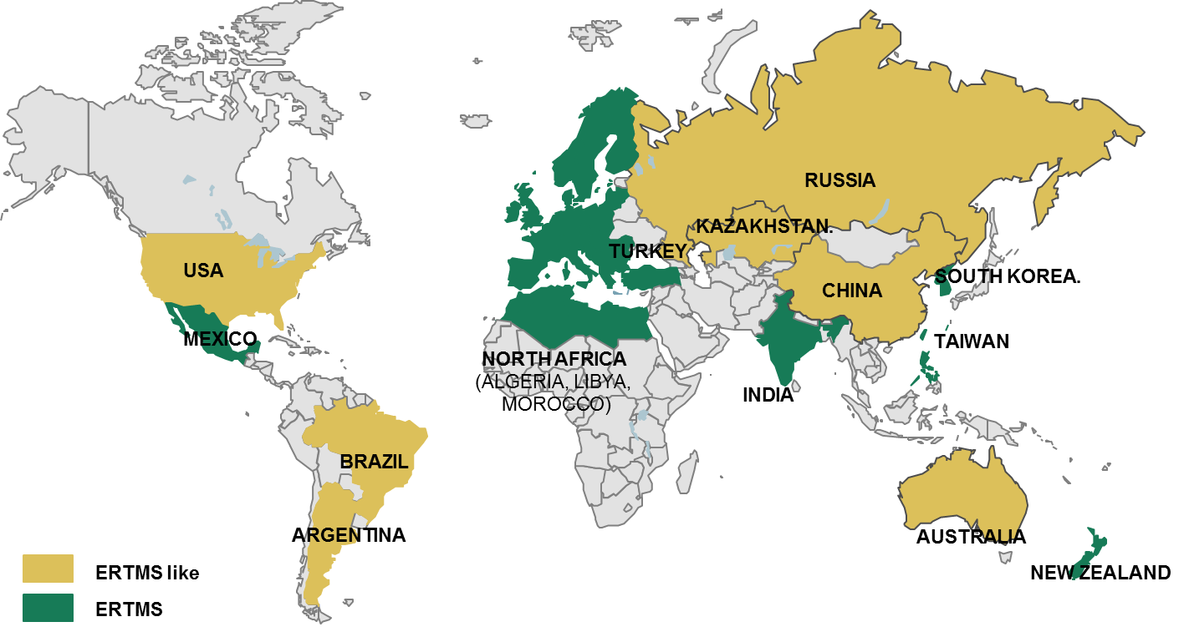
ERTMS: more export opportunity
EGNOS
SDCM
WAAS
MSAS
GAGAN
ERTMS can benefit from the EGNOS-compatible networks in the world

Slide 8

The Shift²Rail initiative would contribute to developing rail as a transport mode by promoting step-change innovations for passenger rolling stock, freight transport, traffic management systems and rail infrastructure
EGNOS-GALILEO are key enabling technologies to contribute to the challenging goals for a more
efficient rail transport system but with
important industrial returns in each of their economical sector
EGNOS for rail can be used up +60 times the whole aviation sector
Satellite-based solutions for Train Control Systems

Slide 9

SHIFT²RAIL in a nutshell
16 December 2013: Publication by the European Commission of a legislative proposal to launch SHIFT²RAIL, an ambitious new European Research & Innovation Programme that aims to:
  Increase the competitiveness of the EU rail industry to help it retain world leadership
  increase the attractiveness of rail transport.
A future public-private Joint Undertaking under Horizon 2020
Proposed budget of 920 Million Euros for 2014-2020, including 450 Million from the EU and 470 Million from the Industry
Already nearly 3 years of intense work by the rail sector for the technical preparatory phase (coordinated by UNIFE)
A historical opportunity for numerous rail stakeholders all over Europe!

Slide 10
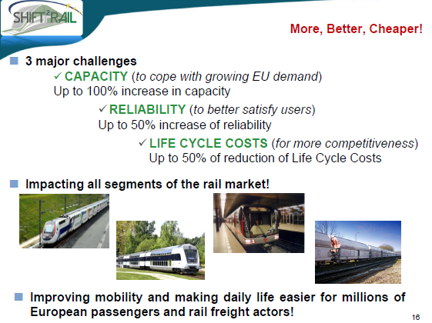
GNSS contribution to Shift2Rail
GNSS
contribution

Slide 11
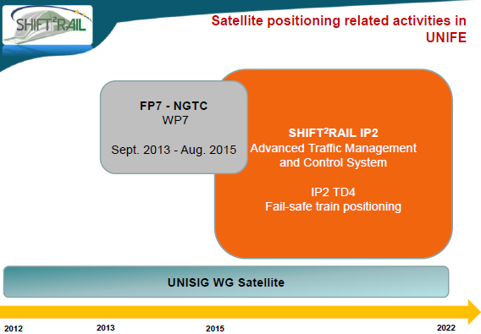



….a roadmap to the future….
GSA cooperation
Early Services

