Slide 1



Which blockchain?
The future at a crossroad
Antonio Sassano
Roma 12 Dicembre, 2017

Slide 2





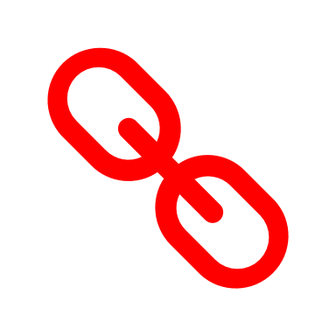
The Distributed Ledger (BlockChain)
Private Key A
Transaction 1
A
Public Key A
Transaction 1
Transaction
Signed by A
Transaction 4
Transaction 2
Transaction 2
Transaction 1
Transaction 2
Private Key B
Transaction 3
Transaction n
Transaction n
B
Public Key B
BLOCK
BLOCK
Signed & Readable Transactions (CryptoSignature)
Between anonymous «entities»: Humans or Machines
A transaction can be:
  the effect of an executable code (Smart Contract)
  the transfer of a cryptocurrency
  the trade of any immaterial asset (e.g. spectrum)
A Consensus Algorithm validates the Block
Which Block is the next one?
Proof of Work: Computer power decides
Proof of Stake: Assets «at stake» decide
Algorand: FBA, Sortition and .. Mathematics
Transaction 1
Transaction 2
Transaction n
BLOCK k
BLOCK k+1
BLOCK k+2
BLOCK k+3
The «chain» of transactions is «immutable» and «tamper proof»
Everybody can read and write on the blockchain (Public)
No Centralized Trust Authority «certifies» the transactions
Highly Secure by design (Bitcoin as «showcase»)
Shared and verifiable
by all stakeholders
This is the Open, Public, Permissionless, Borderless, Distributed Ledger

Slide 3
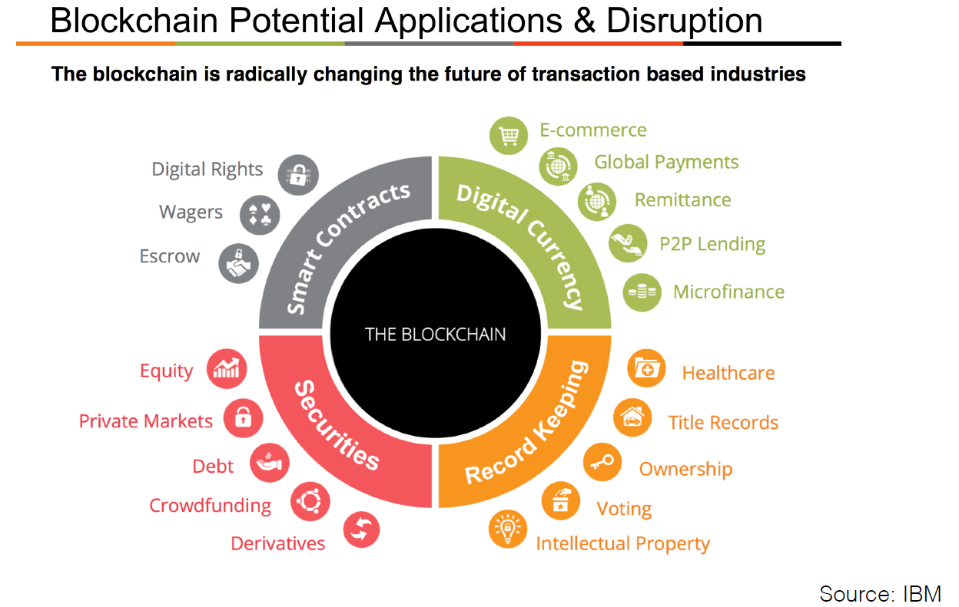
The main takeaway
The Open, Public, Permissionless, Borderless, Distributed Ledger
is (can be) totally disruptive for ALL Central Trust Based Industries

Slide 4
(Only) Public BlockChains are Trustable and Secure
- Only in the Public BlockChain ALL stakeholders decide
- Trust and Security High «by design». Efficiency needs research (Algorand)
- If some stakeholders «do not decide» we have a Private BlockChain
High «by design»
(Consensus Algorithm)
High «by design»
(Bitcoin example)
Low (now!)
All Stakeholders
+ Crypto + Math
Not a BlockChain
Consortium
(Private BC)
Low
Low
High
We have a limited trust
In Central Authorities
Single Point of Failure
Denial of Service
… Hacked Everyday
Dictators are
Efficient
Centralized
Very Low
Very Low
Very High
Consensus
Red Decide
Green Only Stakeholders
Trust
of the Stakeholders
(Cyber)Security
Efficiency

Slide 5















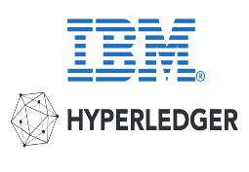
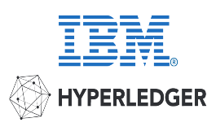

The race to shape Web 3.0 is on
Web 2.0 non-interoperable silos (platforms)
APPS
CLOUD
Platforms
Internet Protocol
«Lean» Open Protocol
DAPPS
Web 3.0 Private BlockChain
CORDITE
ORACLIZE
Nothing «really» changes
Central Control and Silos
Data to Dapps and Platforms
In OTT .. We Trust
No interoperability
Efficiency «for free» (no research)
Private
BlockChains
CLOUD
Platforms
Internet Protocol

Slide 6
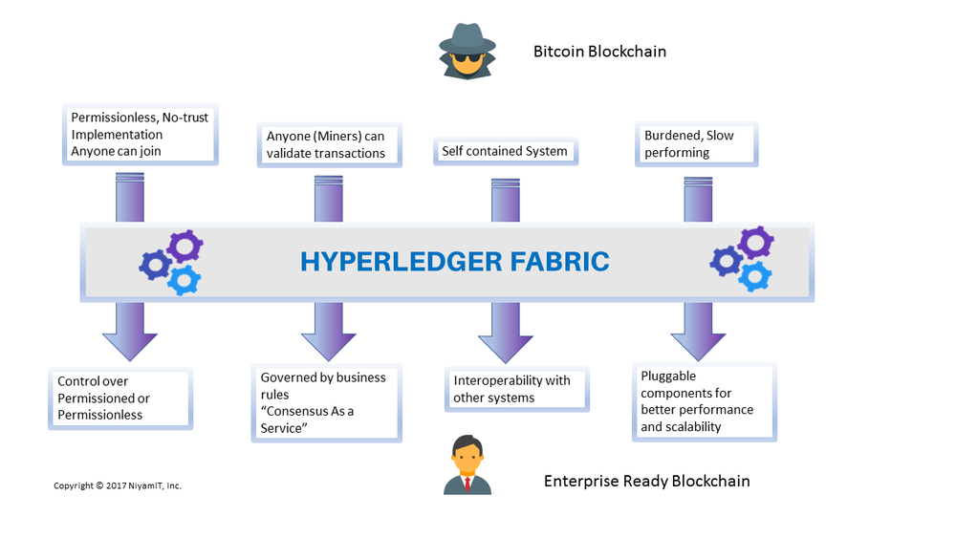



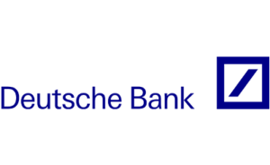
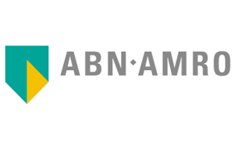


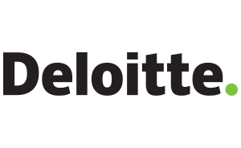
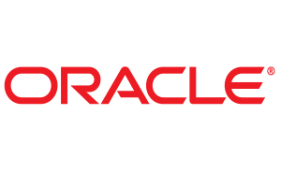



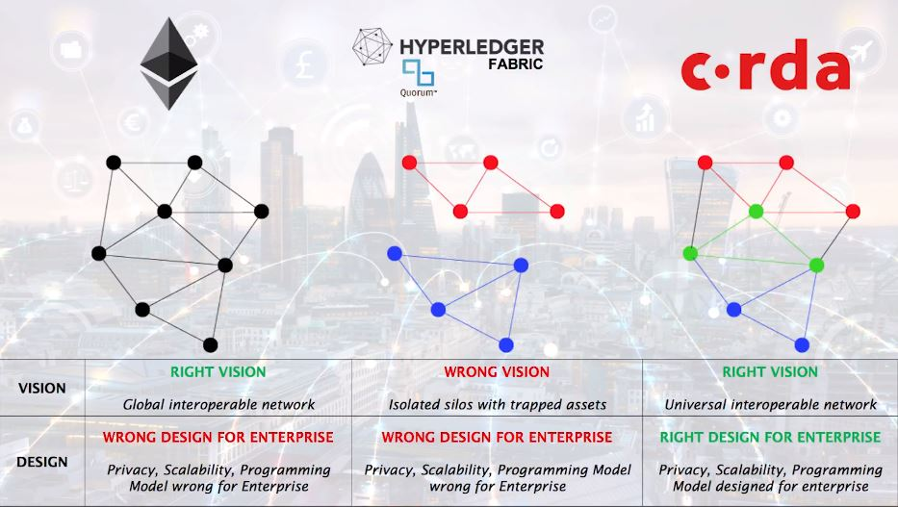







… and is an information war
Banks + Mgmt Cons + Tech
Bitcoin BlockChain? BAD!
Why? No Trust, Slow and …
… anyone can join / validate!
Banks + Mgmt Cons + Tech
Hyperledger?: Isolated silos !
Corda? Same as Ethereum but .. «Right design for enterprises»
SeminariBordoni BlockChain - 25 Settembre, 2018

Slide 7


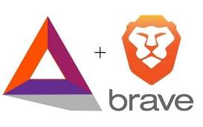

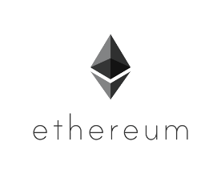




The «new beast» is the Public BlockChain
Web 2.0 non-interoperable silos (platforms)
APPS
CLOUD
Platforms
Internet Protocol
Web 3.0 Public BlockChain
DAPPS
Decentalised Cloud (IFPS)
Decentralised Control
Data owned by producer
«Fat Protocol» paradigm
Tokens move value downward
Democracy «by design»
STREAMR
BITCOIN
BANCOR
BRAVE + BAT
Public BlockChain
ALGORAND
EOS.IO
Internet Protocol

Slide 8
Who will prevail?
The History of Internet:
  The dream: A resilient network without a C&C Center
  The (once) Big Platforms Attempt (’80-’90) «We are the secure, fast and efficient network»:
    DNA (DECNet Internet 17k Nodes in 1989)
    SNA (IBM), DSA (Honeywell)
  TCP/IP and the WWW made all of them obsolete!
Here we are again:
  The dream: A resilient «book of transactions» with no Central Trust
  The Big Platforms Attempt: Private BlockChain
  But can Notaries, Bank, Insurance, Administrations, OTT, …. Intermediaries in general survive in a Distributed World ?
  Or Public, Open BlockChain will make all of them obsolete!
  We do not know. But surely two things are mandatory:
    Research and sharing of (good) Knowledge
    Experiments on real life problems
SeminariBordoni BlockChain - 25 Settembre, 2018

Slide 9
the role of Fondazione Ugo Bordoni
Basic Skills:
  Cryptography and (Cyber)Security Certification
  Data Mining
  Telecommunications (Network, Spectrum)
  Knowledge of PA processes
Our Goals:
  Foster a Permanent Forum on «Distributed Ledger» Technology
  (Active) Participation to the European BlockChain Forum
  (Active) Participation to the Italian Task Force on BlockChain
Our Experimental Projects:
  BlockChain for Dynamic Spectrum Management
  Internet of Things – MicroPayments (5G)
  Supply Chain Certification (Fraud Detection)
  Digital and Authorship Rights Management
SeminariBordoni BlockChain - 25 Settembre, 2018

